Slide 1
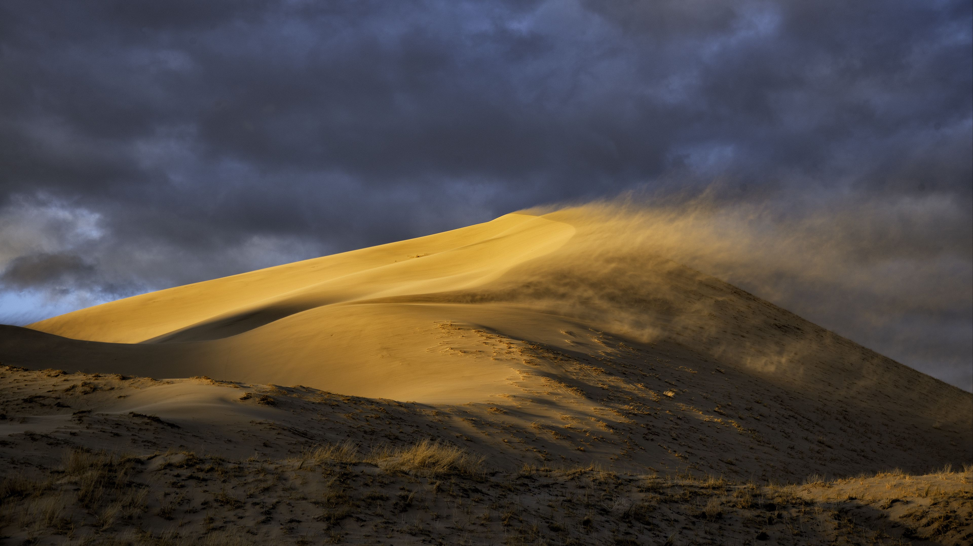

Wind in the Wilderness
A Lenten Series from the Prophets
Living into God’s Vision of Justice

Slide 2
Perpetua Titling MT 60pt
Calibri (Body) 32PT

Slide 3


